Slide 1

Kamla Education Society’s
Pratibha Institute Of Business Management
Chinchwad, Pune-411019
2025-2026
Project Name : Brief Analysis On Employee Survey
Class : MCA 1St
Roll No : MC25059
Subject : Mini Project
Submitted BY :
Om Shaileshrao Nimmalwar
Guided By :
Prof Rupali Deshpande

Slide 2
Index
Introduction
Problem Statement
Objectives
Scope of the Project
Existing System
Methodology
Software Requirements Specification (SRS)
UML Diagrams
Expected Outcome
Future Scope
Project Overview
Conclusion

Slide 3
Introduction
An employee survey is a method used by organizations to gather feedback from employees about their work environment, satisfaction, and performance. It plays an important role in understanding employee needs, improving productivity, and building a positive workplace culture. The data collected from such surveys helps management make informed decisions for overall organizational growth.

Slide 4
Existing System
In most organizations, employee survey data is analyzed manually using spreadsheets or basic tools like Excel. This approach is time-consuming, lacks automation, and provides limited visualization. As a result, identifying patterns, trends, and key insights from employee feedback becomes difficult and inefficient.

Slide 5
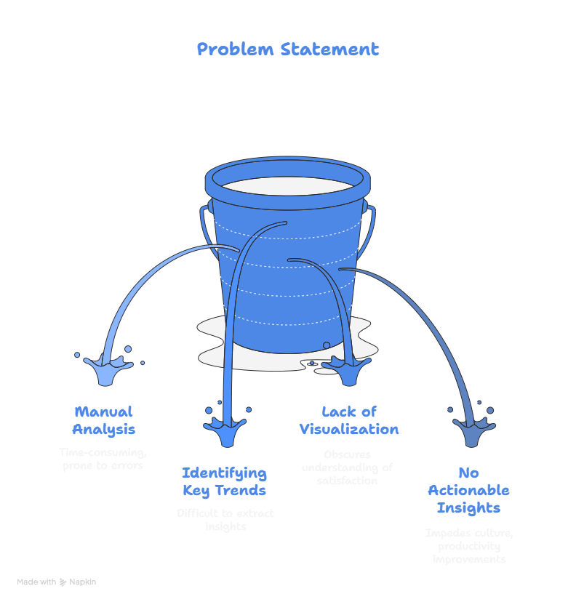
Problem Statement
Organizations struggle to efficiently analyze large volumes of employee survey data.
Manual analysis is time-consuming and prone to errors.
Identifying key trends and insights from raw survey responses is difficult.
Lack of visualization makes it hard for management to understand employee satisfaction clearly.
Current methods do not provide actionable insights for improving workplace culture and productivity.

Slide 6
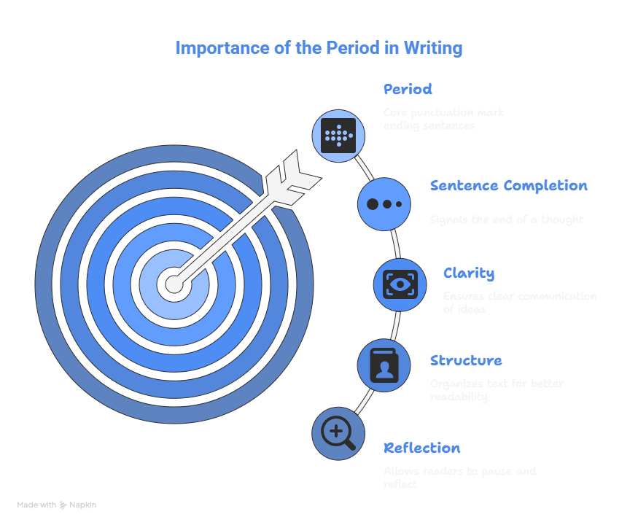
OBJECTIVES
Perform Exploratory Data Analysis (EDA) on survey data.
Identify satisfaction levels and key influencing factors.
Visualize results through charts and summaries.
Support HR decisions with clear insigh

Slide 7
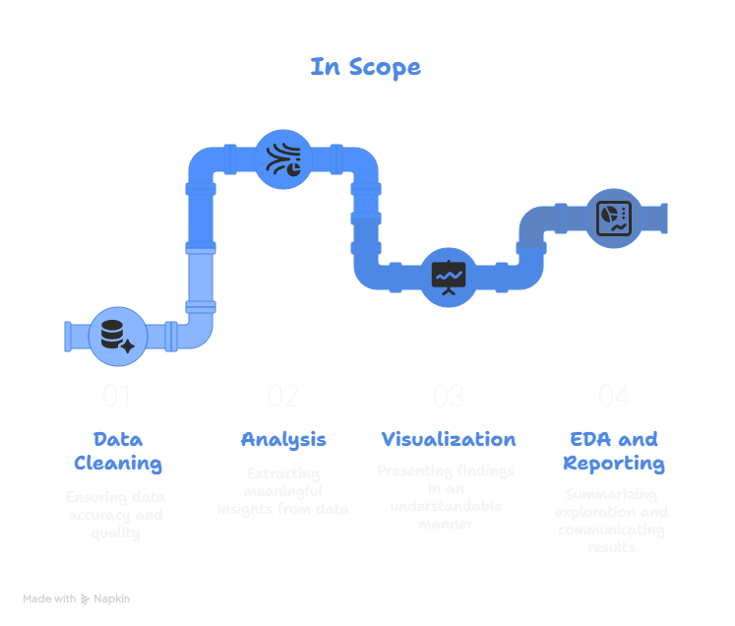
Scope Of Project
This project focuses on data cleaning, analysis, and visualization of employee survey results.It excludes predictive modeling and focuses only on EDA and reporting.

Slide 8
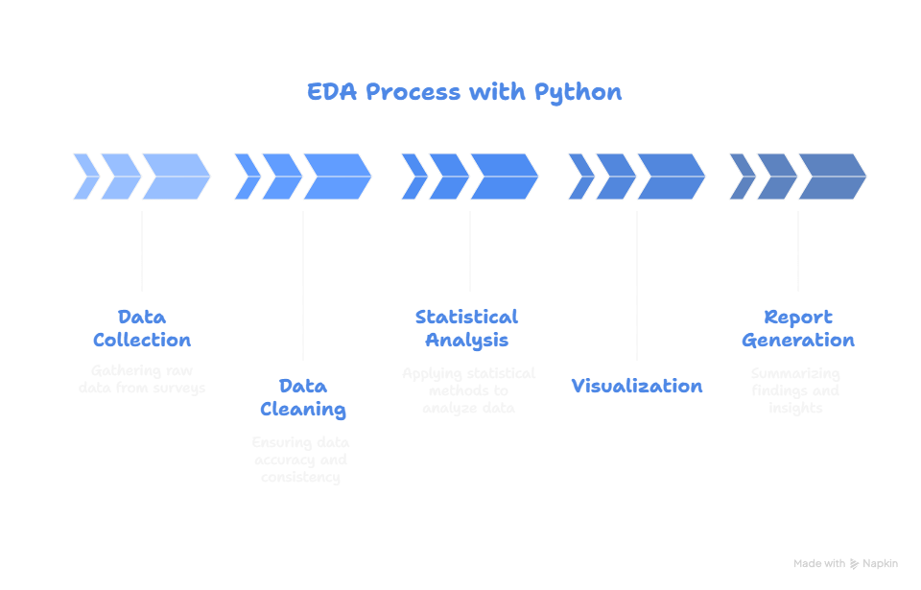
Process Of Project

Slide 9
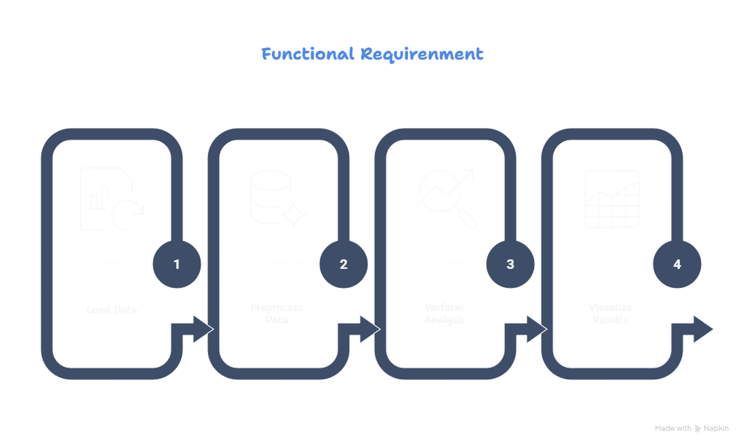
Software Requirement Specification
1. Functional Requirement

Slide 10
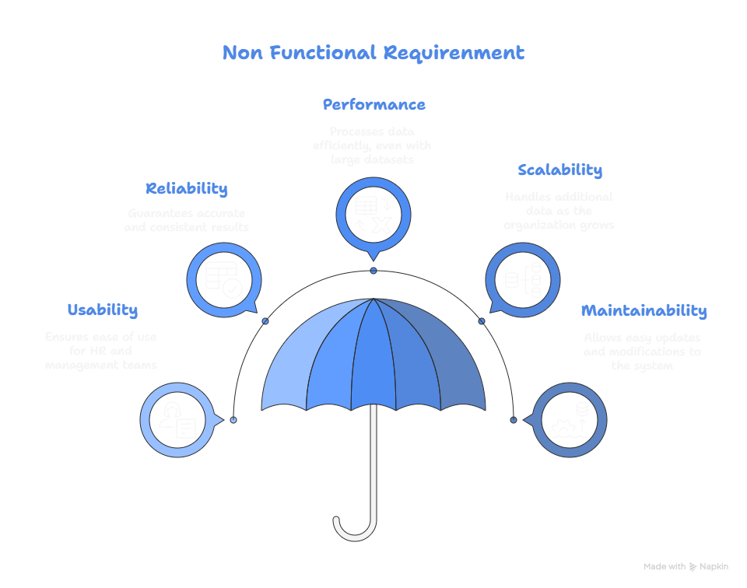
Software Requirement Specification
2. Non Functional Requirement

Slide 11
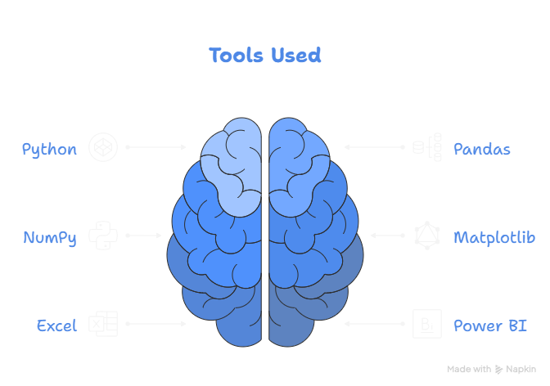
Software Requirement Specification
3. Tool Used

Slide 12
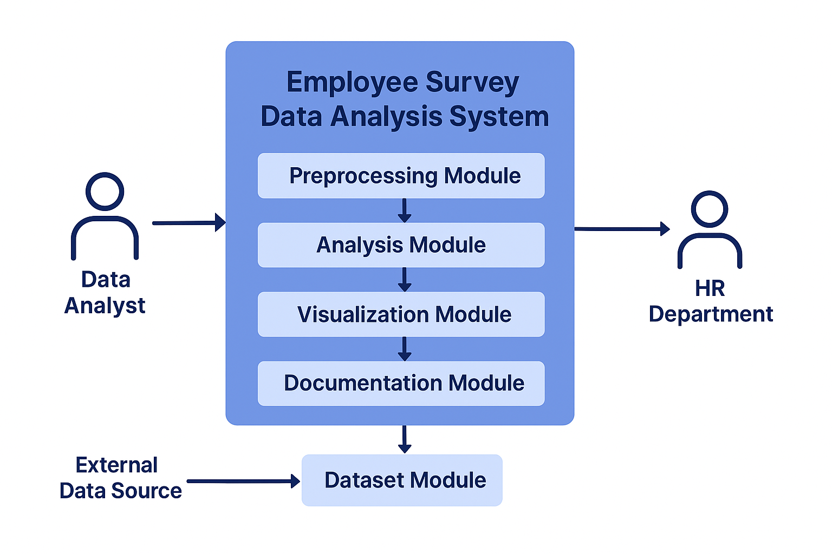
UML Diagrams
1. Context Level Diagram

Slide 13
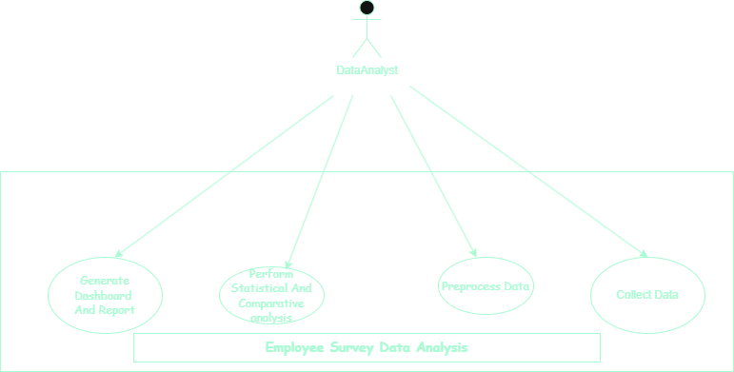
UML Diagrams
2. Use case Diagram

Slide 14
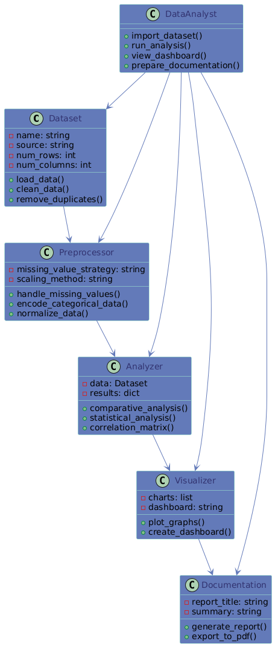
UML Diagrams
3. Class Diagram

Slide 15
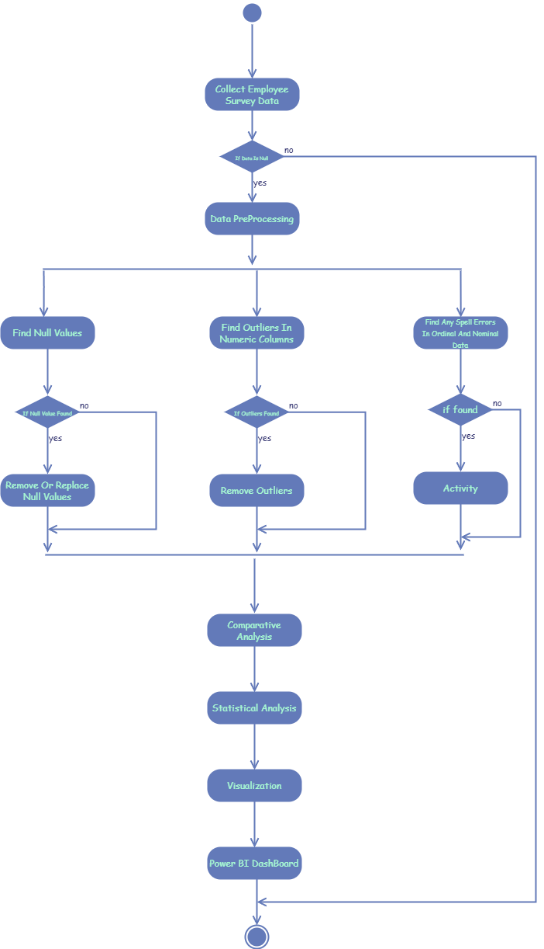
UML Diagrams
4. Activity Diagram

Slide 16
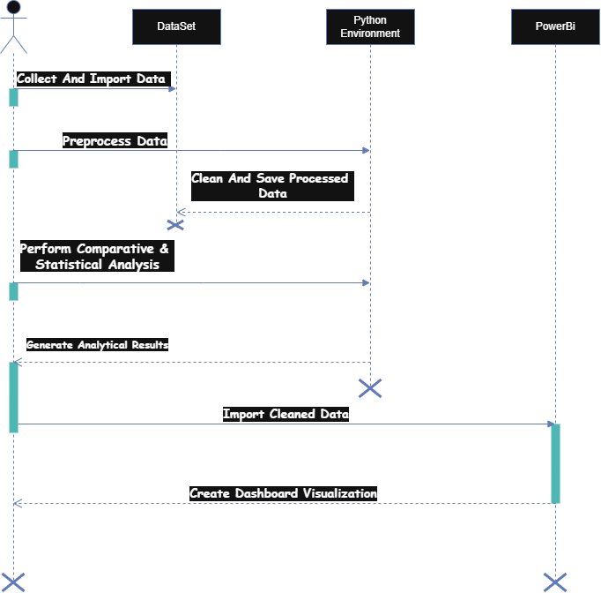
UML Diagrams
5. Sequence Diagram

Slide 17
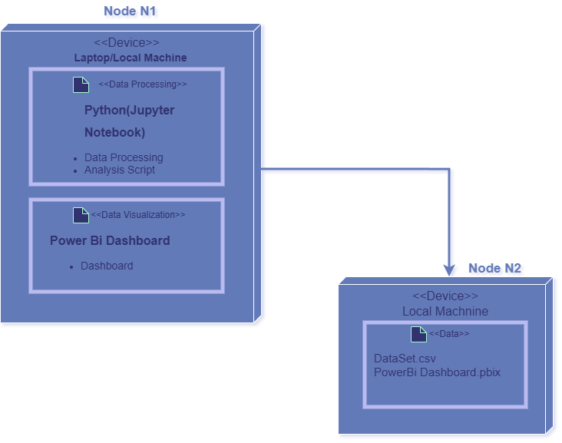
UML Diagrams
6. Deployment Diagram

Slide 18
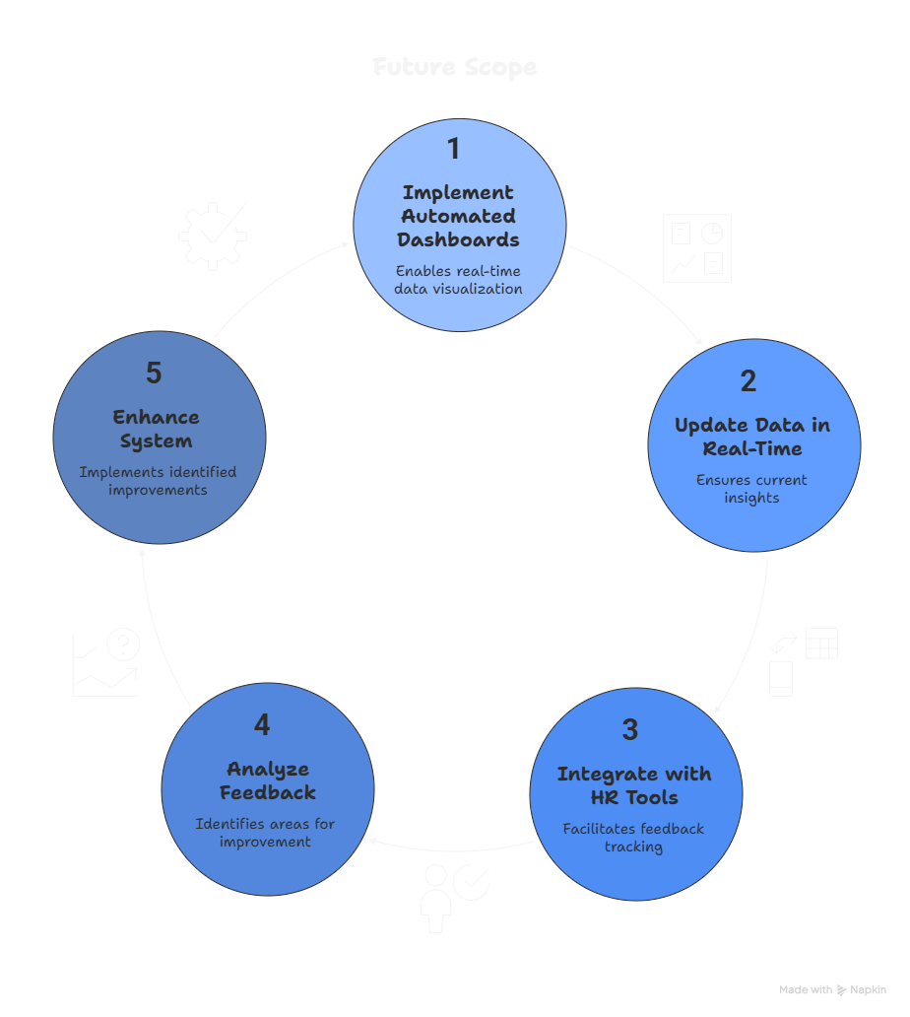
Future Scope
Integration with HR management systems for real-time analysis.
Development of interactive dashboards for continuous monitoring.
Addition of automated report generation features.
Expansion to include feedback prediction and trend comparison over time.
Implementation of cloud-based data storage for easy access and scalability.

Slide 19
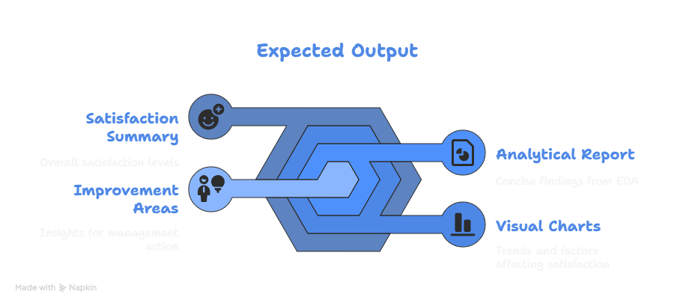
Expected Outcome
A clear summary of employee satisfaction levels.
Visual charts showing trends and key factors affecting satisfaction.
Insights to help management identify improvement areas.
A concise analytical report generated through EDA.

Slide 20
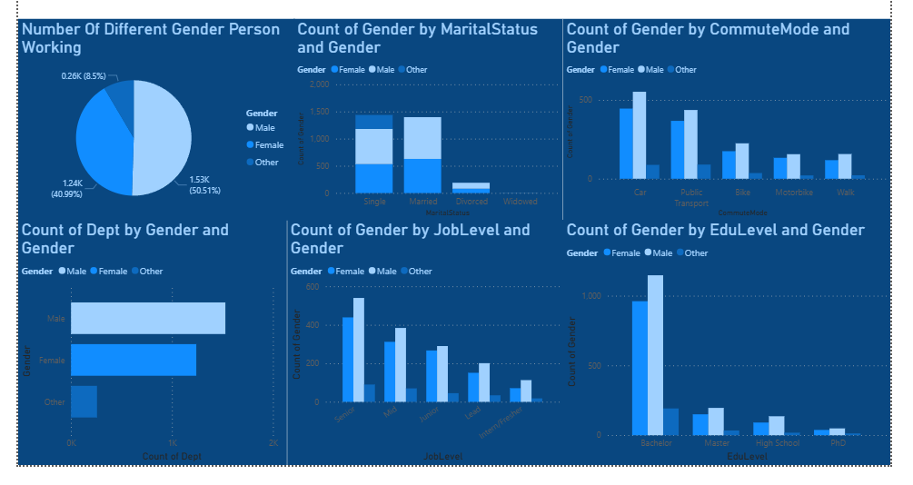
Project Overview

Slide 21
Conclusion
This project focuses on analyzing employee survey data through exploratory data analysis (EDA) to uncover meaningful insights. It helps identify factors influencing employee satisfaction and highlights areas that need improvement. The findings from this analysis can assist organizations in enhancing workplace culture, boosting employee engagement, and supporting data-driven decision-making.

